Slide 1
Supply Chain Collaboration
Lesson content:
Chapter 1 Remote Access V6 / V6
Chapter 2 Data Exchange V6 / V6
Chapter 3 Data Exchange V6 / V4/V5
Chapter 4 Remote Access V6 / V4/V5
Chapter 5 Remote Access V6 / Other Systems
Chapter 6 Data Exchange V6 / Other Systems

Slide 2
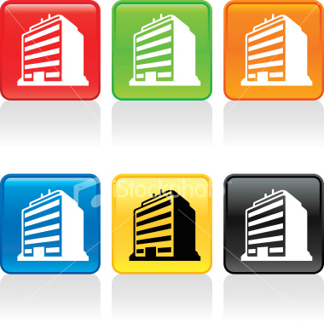
Supply Chain Collaboration: Typology
OEM & Partner practices and development processes are different
OEM imposes practice and development processes
Partner 3
Partner 2
Design in V4, V5 Envt.: VPM V4, VPM V5, SmarTeam, Designer Central, xPDM
Design in V6
OEM & Partner practices and development processes are different
OEM V6
OEM imposes practice and development processes
Partner 4
Partner 1
OEM imposes practices and development
OEM & Partner practices and development processes are different
Partner 6
Partner 5
Design xCAD Envt.: xPDM

Slide 3
Supply Chain Collaboration: V6 Solutions
Data Exchange between V6 Implementations.
Remote Access to a V6 Environment.
Partner 3
Partner 2
Design in V4, V5 Envt.: VPM V4, VPM V5, SmarTeam, Designer Central, xPDM
Design in V6
OEM V6
Data Exchange between V6 and V4/V5 Implementations.
Remote Access to a V6 Environment.
Partner 4
Partner 1
Data Exchange between V6 and with xCAD / xPDM implementation.
Remote Access to a V6 Environment.
Partner 6
Partner 5
Design xCAD Envt.: xPDM

Slide 4
Partners Typology, Recommendations & Solutions
Partner Type * | Characteristics / Requirements | Supply Chain Type | Recommendation / Solutions
Preferred Partner | Risk Sharing Partner. Shares its IP. Needs a non intrusive solution. Needs a direct connection to the OEM environment. | ‘One Virtual Community’ | Remote Access to OEM V6 implementation.
Equipment Provider | Provides out-of-the-box equipments to OEMs and keeps its IP. Needs to handle heterogeneous V6 environments: Different release level Customized data model Filtered IP Ex.: Valeo providing A/C system to Renault | ‘Multiple Communities’ | Data Exchanges
Design Partner | Acts like an OEM design office. IP belongs to the OEMs. Needs a direct integration with OEMs implementation. | ‘One Virtual Community’ | Remote Access to OEM V6 implementation.
Occasional Supplier | Provides complete components and keeps its IP. Needs flexibility to exchange multiple formats with OEMs. | ‘Multiple Communities’ | Data Exchanges
(*) Name can vary depending on the industry

Slide 5
Remote Access V6 / V6

Slide 6




Remote Access V6 / V6: Overview
Creates a Single Virtual Community to Optimize OEM – Partners Collaboration
Partners are directly connected to the OEM environment
OEM & Partners always work on the best so far Product Structure
Reduce collaboration cycle times
Synchronous exchanges
Shared business rules: Change management, life cycle…
No information loss
Intellectual Property access is protected by P&O security
Reduce access to object
Limited access to stream to hide know-how
Attributes filtering through ‘Masks’
OEM
V6
WAN
V6
Partner

Slide 7
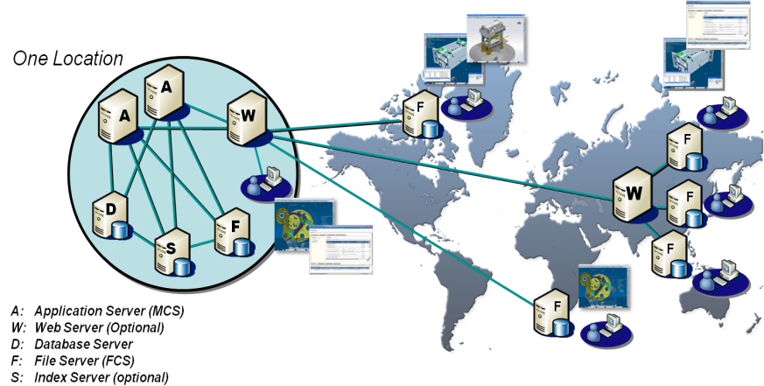
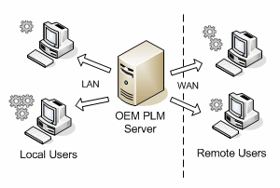
Remote Access V6 / V6: Performances 1/2
Provides Partners with Best-in-Class Online Access to OEM Environment Whatever their Location
Centralized Database Architecture with Distributed File Stores
Web clients “re-directed” to most appropriate file server to eliminate file transfers across Wide Area Network (WAN)
Single schema with site-specific differences
Optimize performance with File Caching
Store cache supports Read/Write access
Update of PLM metadata over the (Wide Area Network) WAN
Asynchronous update of vault are performed over the (Wide Area Network) WAN

Slide 8
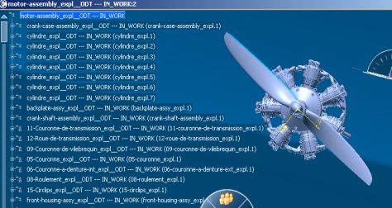
Remote Access V6 / V6: Performances 2/2
Provides end user with acceptable response time whatever the distance
V6 is designed to work over the WAN
V6 Service oriented protocol without chat
Message compression
Distributed FCS & cache mechanisms
Limited Wan overhead even with poor latency (250 ms)
Notes:
The ability to add proportional amounts of workload and resources while maintaining performance).

Slide 9



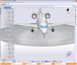

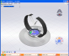
Remote Access V6 / V6: Architecture & Network Security
Provides Critical IP Protection for Secured Online Collaboration
Secured access to OEM environment
Support HTTPs protocol and proxy / reverse proxy
Firewall
Firewall
Firewall
https
(MCS) MATRIX Collaboration Server (FCS) File Collaboration Server
Phase 2
https
https
http
Phase 2
Phase 2
Phase 2
http
Phase 2
Phase 2
Proxy ie, apache
Reverse Proxy
ie, apache
V6 Server
DB
third party
third party
File Storage
(FCS)
File Collaboration Server
ftp
File synchronization
Phase 2
Phase 2
Phase 2
sip protocol
Phase 2
Phase 2
Phase 2
DMZ
Collab Server
third party
Remote Site Network
Public Network
OEM Network

Slide 10




Remote Access V6 / V6: Deployment
Benefits from Industry Proven Implementation Methods
Deployment topology: STORE, LOCATION, SITE, FCS
At Read/Write operation, the file will be located according to SITE/LOCATION/STORE definition in metadata database.
For a given STORE, files will be provided by:
FCS server for persons defined on the SITE → Data stored in the LOCATION
MCS server for persons not associated to a SITE (default value) → Data stored in the STORE
On-demand Synchronization
MCS (Matrix Collaboration Server)
Pune
DB
FCS File Collaboration Server
FCS File Collaboration Server
Bengalore
STORE
Delhi
India
Europe
SITES: INDIA
Pune
Bengalore
Delhi
STORE
LOCATION
SITE
USER
LOCATION

Slide 11
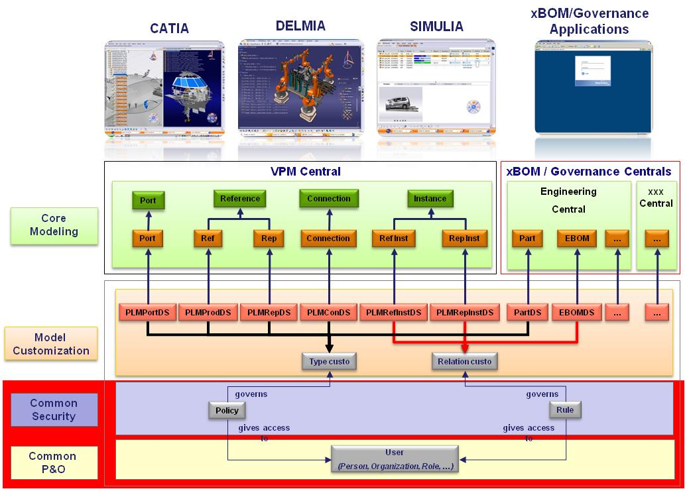
Remote Access V6 / V6: Security & Confidentiality Management 1/5
Provides a Flexible, Robust & Secured Access to IP
A common & consistent security solution
Whatever the access (Wintop / Webtop)
Whatever the DS Applications
Mechanical modeler
VPM Physical editor,
VPM Functional editor,
Piping & Tubing Logical Editor
…
Whatever the process mode (interactive/ batch mode)

Slide 12
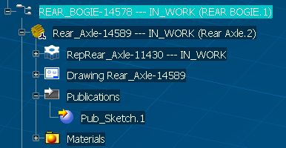
Remote Access V6 / V6: Security & Confidentiality Management 2/5
WHAT is Protected?
Access control on Data
VPM objects
PLM Reference
PLMPort
PLMConnection
PLMCoreReference
PLMCoreRepReference
PLM Intance
PLMCoreInstance
PLMCoreRepInstance
XBOM Governance objects (CBP)
Requirements
Documents
Program
…
Access control on Resources
Settings
Tables of values
Services: (functions)
Applications
…
Access control on Function
Container
PLM Port
WHEN Security is Enforced ?
At login time to compute masks, user commands and resources
At query time on PLM objects with filters
At expand time on PLM structure with filters
At Save time on PLM objects on create, modify, delete, changeowner, ….
At transaction time on PLM objects : transfer, promote, newversion, lock, unlock ….

Slide 13
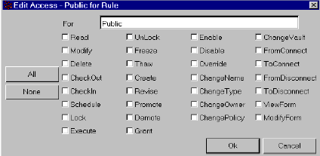
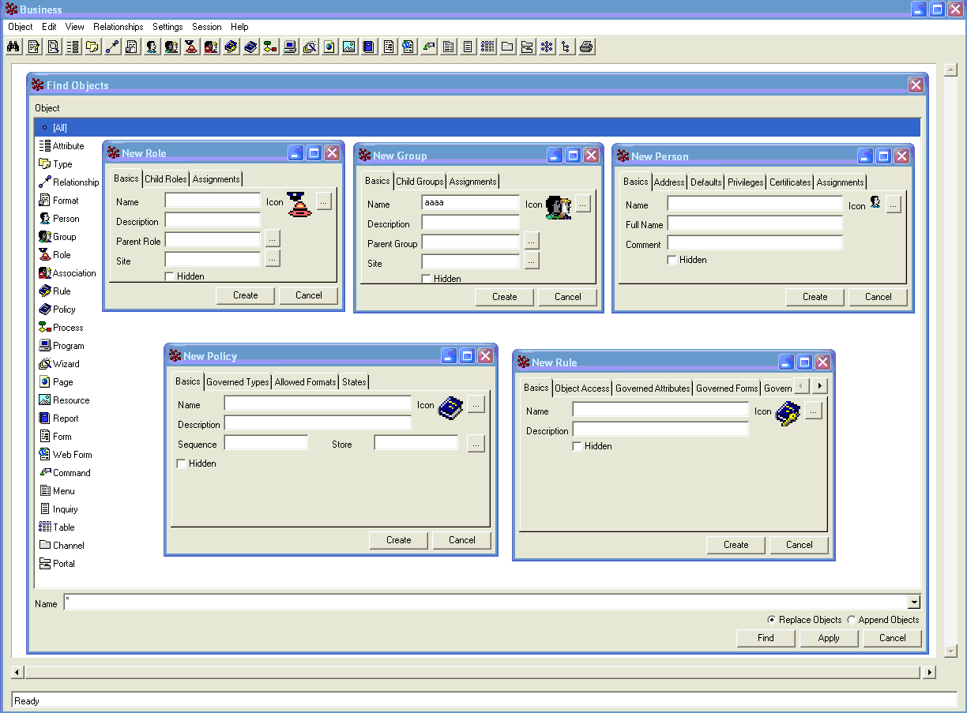
Remote Access V6 / V6: Security & Confidentiality Management 3/5
HOW is it Enforced?
Policies-Rules
Function
Object access
Grants permission to Person, Organization, Role, Project
Conditioned by Security rules (filters)
Triggers, Scripts, User exits
Resources Bundle
Parameters, PRM, Settings, Icons, NLS
Metadata masks
On attributes

Slide 14







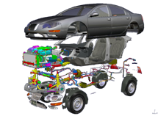



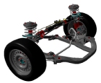
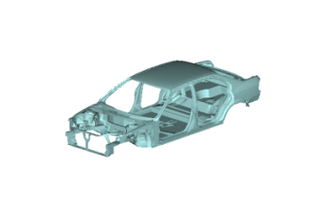
Remote Access V6 / V6: Security & Confidentiality Management 4/5
Key functionalities
Ability to describe PLM P&O resources
Organization
Person, BuddyList
Role
Project
Ability to assign persons to a working context depending on a role, an organization and a project.
MyCompany
Product
System
Integ
System
Eng
Program
Mgt
ILS
Aux
System
Person
X
System
Air
System
Fluid
System
Life
Support
Mech
System
Mech
Handling
Support
Fluid
System
Door
Other
System
Assignment
Working Context
Descrip
Schemat
Drawing
Other
Test, etc
Organization
Role
Project
Architect
Reviewer
Designer

Slide 15
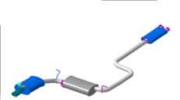


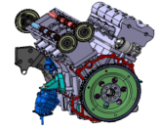
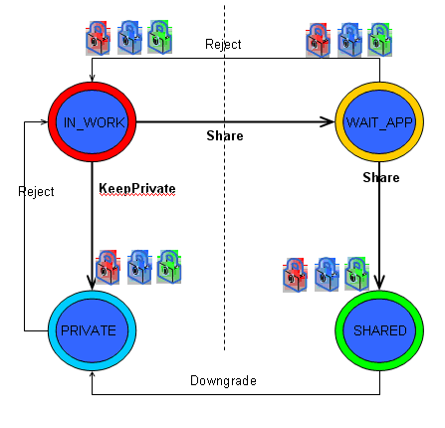
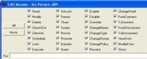
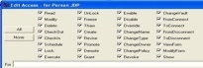
Remote Access V6 / V6: Security & Confidentiality Management 5/5
Organizations
Context 1
Context 2
Organizations
Team1
SupA
Projects
J.Doe
Team1
SupA
Projects
MyCompany
Exhaust
MyCompany
Exhaust
Roles
Power train
Roles
Power train
Designer
Body in White
Designer
Body in White
Reviewer
Engine
Reviewer
Engine
Policy A1 on PLMreference
Rules
Policy B3 on PLMConnection
Access/Read/show/FilterMyData Designer
Read/Show access
Designer
Access/Read/show/FilterMyData
Designer + Reviewer
All access right of an object will be tied to the aggregating reference lifecycle and rights to manage the data integrity and consistency
Stream
Skate type
Connection type
Rep1 type
Policy A2 on PLMPort
Access/Read/show/FilterMyData Designer
Ref data integrity and lifecycle scope
Rep data integrity and lifecycle scope
Interface Left W
From
To
Wheel ref type
CNX
Rep2
Relationship
Port Publication type

Slide 16
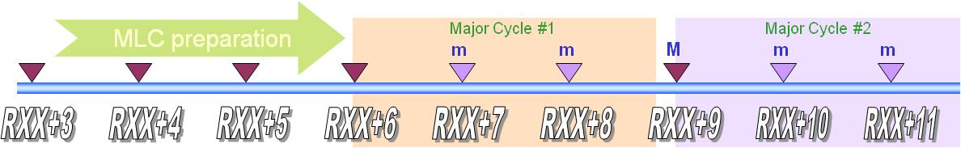
Remote Access V6 / V6: Multi Releases Support 1/2
Provides Critical Flexibility to Implement and Adapt V6 to Customers Evolving Needs and Environment
DS Fundamentals for CATIA/ENOVIA Compatibility
ENOVIA will support only CATIA release equal or upper level
ENOVIA release N support CATIA release N, N+1, N+2, etc
CATIA release from lower level are not supported as it leads to unacceptable constraints for application evolutions (see next slide)
These rules are only valid in a same Major Release Cycle, between Minor V6 Releases (DS R&D will precise which releases are ‘Major’ vs. ‘Minor’)
ENOVIA Database Upgrade
Strategy is to upgrade clients first
When client have all been upgraded on a given level (or upper), server can be upgraded
No -or very limited- influence to user’s day-to-day business
Upgrade of Client can be done one by one ; other Clients are unaffected
Server upgrade for a MLC release can be handled within 24 hours downtime

Slide 17
Remote Access V6 / V6: Multi Releases Support 2/2
Provides Critical Flexibility to Implement and Adapt V6 to Customers Evolving Needs and Environment
Major cycle
CLIENT/SERVER SYNCHRONIZED BUT SOME DATA HAS BEEN CREATED IN Rx+2
All the Rx functionalities are fully accessible
Rx user can read data created in Rx+p but a check is done during open and maybe some data will be declared unreadable:
If data does not contains new features, specifications are also readable and the part is fully editable in Rx
If data contains new features: the part is visible and its geometry can be referenced in Rx but specifications are not readable
Major release
mlc release
mlc release
Major
release
V6Rx
V6Rx+n
V6Rx+p
V6Rx+p+1
…
CLIENT IN ADVANCE
Functionalities existing in Rx: no change: they can be used as usual
New Rx+p functionalities:
If they do not require new metadata unknown in Rx: these commands can be used
If they require new metadata unknown in Rx, these data cannot be saved: these commands should be grayed (no impact for end user)
V6Rx
V6Rx+n
V6Rx+p
V6Rx+p+1
Upgrade
Upgrade
Migrate
A major cycle is common to all (infrastructure, modelers, applications)
Possible connection
Notes:
Qqs reformatages, 2 ou 3 clarifications

Slide 18
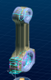
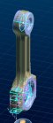
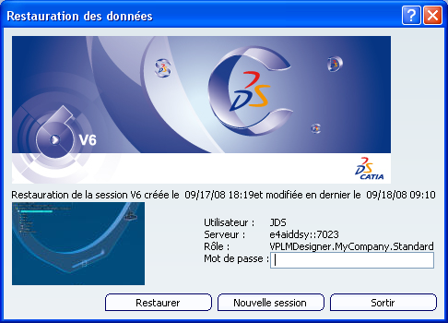
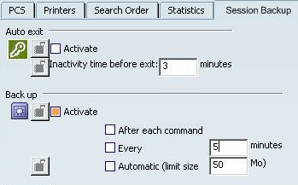
Remote Access V6 / V6: Session recovery
Enables to Maintain the Integrity of PLM Data during Incidents (Blackout, etc)
Temporary save
Design is always performed in connected mode
Save locally n times (manual or automatic)
Save in the database 1 time
Master Site
CLIENT
synchronization
WAN
DB
FCS local
MCS
FCS master
SAVE
User Disk
backup 1
backup 2
backup n

Slide 19

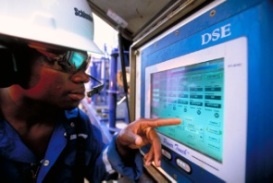
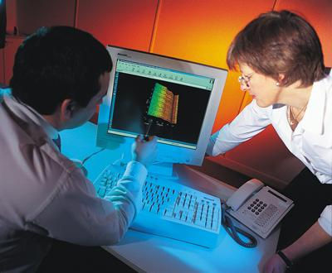
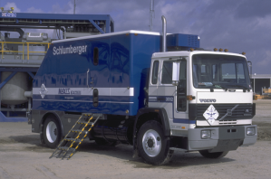
Remote Access V6 / V6: Design Anywhere, Build Anywhere 1/3
Business Drivers
Increase outsourcing and collaborative manufacturing
Distributed organization and employees
Design where it makes sense
Build where it makes sense
Benefits
Reduced FTT from 4-6 months to 10-30 days
Achieved 20% increase in ECO release output
ECO process time cut by 50%
Boosted design productivity
Enables flexible manufacturing
Provides global sharing of content
Allows local modification and design management
Over 3,700 active users
500 concurrent users
Nearly 4.3 million objects
1.3 terabytes file storage
Notes:
Global Matrix for Schlumberger as delivered at GCC2005 by Dick Starr, Manager, Global Support Technology Center Business Systems
Over 3,700 named users
500 concurrent users
Nearly 4.3 million objects
1.3 terabytes file storage
Since go-live
781K items created
1,050K items released to Mfg
1,182K documents plotted

Slide 20


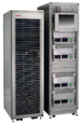
Remote Access V6 / V6: Design Anywhere, Build Anywhere 2/3
ENOVIA MatrixOne Deployment 2005
MRP
Scandinavia
MRP
MRP
Protel
MRP
Paris
Houston
Acad
Pro/E
MRP
Tokyo
Cadence
Product Support
Document
Portal
Singapore
5,000 active users
500 Concurrent users
5 million objects
1.5 Terabytes file storage
Average Daily Activity:
1,040 items created
1,400 items released to manufacturing
1,580 documents/drawings plotted

Slide 21
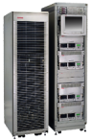
Remote Access V6 / V6: Design Anywhere, Build Anywhere 3/3
ENOVIA MatrixOne Deployment 2007
MRP
Scandinavia
MRP
MRP
Protel
MRP
Paris
Siberia
Houston
Acad
Pro/E
MRP
Tokyo
Cadence
Product Support
Document
Portal
Singapore
5,000 active users
500 Concurrent users
5 million objects
1.5 Terabytes file storage
Average Daily Activity:
1,040 items created
1,400 items released to manufacturing
1,580 documents/drawings plotted

Slide 22
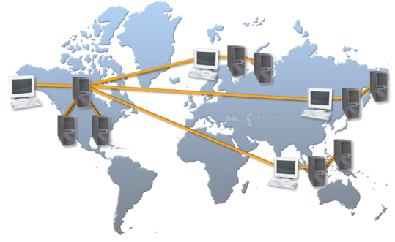









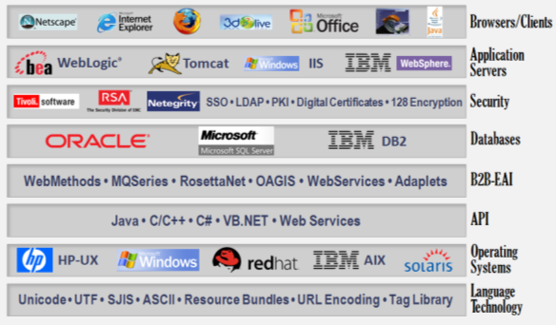
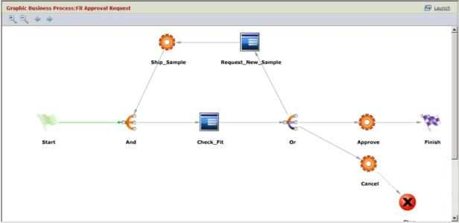




Remote Access V6 / V6: Proven, Scalable, Open, Flexible
GLOBAL
SCALABLE
Certified Benchmark
Largest PLM Implementations in the World
25,000+ concurrent users
Named Users | Concurrent Users
1,000 | 170
7,000 | 1,170
15,000 | 2,500
22,000 | 3,670
31,000 | 5,170
46,000 | 7,670
120,000 | 20,000
150,000 | 25,000
4,000
12,000
5,000
30,000
20,000
12,000
*Results by Sun Microsystems
100,000
6,000
3,000+
11,000
4,000
4,000 users expected
9,000
10,000+
Continuous Improvement • Predictable Results
OPEN
FLEXIBLE
Page 22
Notes:
22

Slide 23
Data Exchange V6 / V6

Slide 24





Data Exchange V6 / V6: Overview
Enables to Manage Multiple Supplier Communities Offline
Support exchanges between different customized data model
OEM and Supplier have their own PLM environment
Enable Supplier to work with different OEM
Enables to exchange any kind of PLM data
Supports large amount of data
No data loading in CATIA for Export & Import
Controls export of data through filtering
Checks information before import
User activity focused on process decisions
World wide Unique internal identifier used during all exchange processes allows automated updates
No manual reconciliation is needed
Support any round-trip exchanges
Multiple exchanges between OEM and Supplier
Supports multi-tier supply chain
V6
V6
3DXML with Authoring
OEM
Partner

Slide 25
Data Exchange V6 / V6: 3DXML with Authoring
Leverages 3DXML Standard Based Format for Rich Semantic Exchanges
Two types of 3DXML files can be generated and exchanged
3DXML for Review
Dedicated to design review type of scenarios
Contain only light representation of the geometry
Markup and annotations can be added
FT&A can be exported (XML Mesh)
3DXML with Authoring
Enables round trip exchanges with complete context including exact geometry as well as meta-data
Supports exchange between V6 implementations with different customizations
Core attributes are exported: data identification, creation date, version sequence number, etc.
Exact geometry and meta-data are private

Slide 26

Data Exchange V6 / V6: 3DXML with Authoring Import
3DXML with Authoring - Import as Reference
Enables co-development / co design with roundtrip exchanges between an OEM and its partners.
Import objects with identical name and internal identifiers as the originating site.
Objects cannot be edited as the ownership remains with the originating V6 site.
Links are kept.
Automatic updates can be received to keep the object up to date (only the changes since the last update are imported).
Variant: data can also be duplicated and then versioned to better control the re-integration of modified data in existing V6 environment. (A1 on the schema)
3DXML with Authoring - Import as New
Enables to create a new object as a copy of the original to support carry over scenarios.
The receiving site becomes the owner of the object, applying new internal identifiers, business rules and lifecycles from the receiving site.
The imported data can be edited.
V6 Env. 1
V6 Env. 2
A
B
Export A 3DXML with Authoring
A
Edit
A1
A’
Import A 3DXML as Reference
A’
B
Save as
As Ref.: Review, Design in context
V6 Env. 1
V6 Env. 2
A’
Import A 3DXML as New
A
As New: Edit

Slide 27
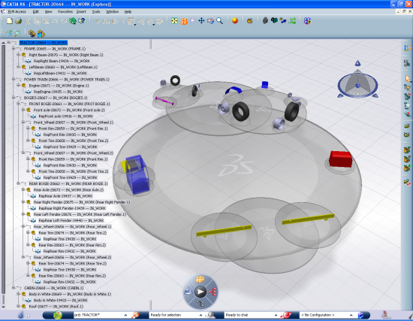
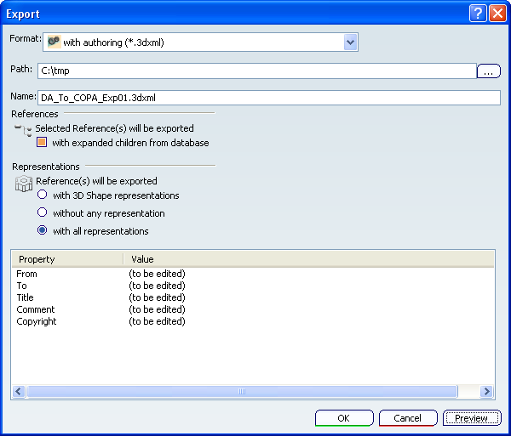
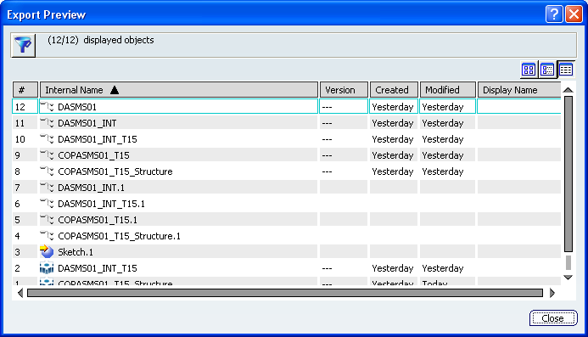
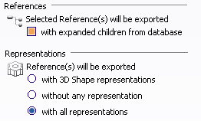
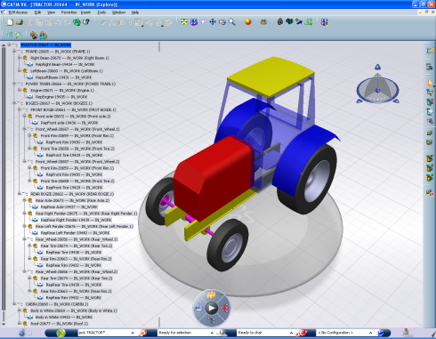
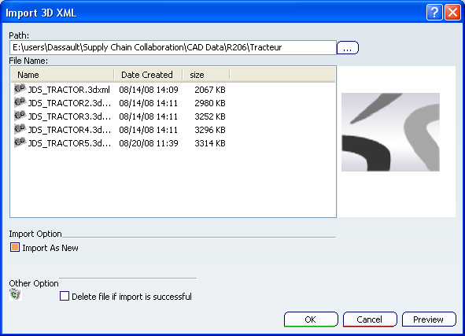
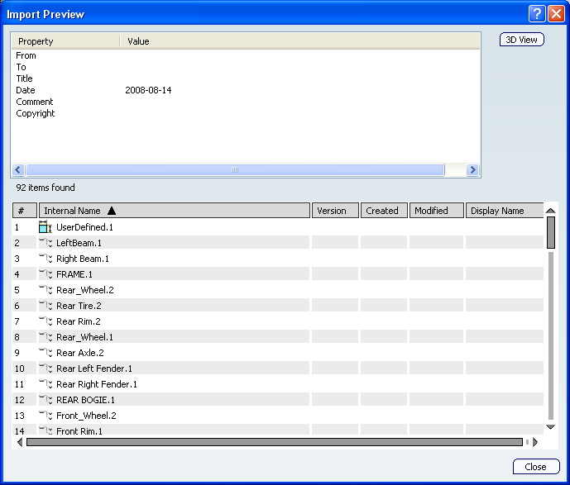
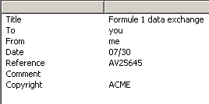
Data Exchange V6 / V6: 3DXML with Authoring Export / Import
Extract a sub-set of the whole design
Control the content of the package before import
Export selection in context
Export only what you need
Preview the data list before export
Get information from emitter thanks to 3D XML identity card
Preview 3D XML content

Slide 28
Data Exchange V6 / V6: Support Customized Data Model 1/2
Enables to Accommodate Data Exchanges Between Various V6 Implementations with Different Customizations
3DXML with Authoring files are composed of two parts:
Core data (CD): This is the core description of the object, that can be shared with all other enterprises.
Extended Enterprise (EE): Additional enterprise-specific information needed to integrate the object into enterprise processes.
3DXML with Authoring
Lifecycle (ex: maturity)
P&O attributes (ex: user/project/org)
All Custom attributes
EE: Enterprise-specific data
CD: Core data shared with other enterprises
Naming attributes (PLMExternalID, V_Name)
All modeler attributes
All relation design
All streams (Representation)

Slide 29
Data Exchange V6 / V6: Support Customized Data Model 2/2
Enables to Accommodate Data Exchanges Between Various V6 Implementations with Different Customizations
OEM
Supplier
Type | OEM Part
Maturity | Under Study
User | Joe
OEM Ref. | XXX
Invoice ID
Name | Bolt_2012
Ext ID | X1250A
Length | 30 mm
Diameter | 5 mm
1
Type | Supplier Part
Maturity | In Work
User | Bill
SUP Ref.
Ref. Order | XXX
Name | Bolt_2012
Ext ID | X1250A
Length | 30 mm
Diameter | 5 mm
Customized attributes and Core Data are exported
Enterprise specific data
2
Customized attributes can be imported into supplier’s environment
Core data
Export (3DXML with authoring)
Import (as reference)
3
Type | OEM Part
Maturity | Under Study
User | Joe
OEM Ref. | XXX
Invoice ID | YYY
Name | Bolt_2012
Ext ID | X1250A
Length | 30 mm
Diameter | 5 mm
Type | Supplier Part
Maturity | Achieved
User | Bill
SUP Ref. | YYY
Ref. Order | XXX
Name | Bolt_2012
Ext ID | X1250A
Length | 30 mm
Diameter | 5 mm
Supplier modifies its own Enterprise Specific information
5
Import (as reference)
Export (3DXML with authoring)
Customized attributes are re-imported into OEM’s V6 environment
He can also modify customized attributes
4

Slide 30
Data Exchange V6 / V6: Multi Releases Support
Provides Critical Flexibility to Implement and Adapt V6 to Customers Evolving Needs and Environment
Exchange of data between different ENOVIA servers
Upward exchange is supported up to 2 releases up
Upward exchange will be supported over major release cycles
Downward exchange is supported with rules
Major release cycles: Minimum content supported in downward exchange
Product Structure
Exact Geometry without specification access
Minor release cycles: rules will be applied according to available content in release N-1
Transfer ownership is rejected by default
In case of release up, transfer ownership can be forced UI wise
In case of release down, transfer ownership can be forced UI wise with following risks:
Definitive loss of missing information in target release (possible risk)
Possible consistency loss between different copies of this object at various partners’ sites only a detach + re-import can solve
In such a case where object has lost information, any site ownership transfer is rejected

Slide 31

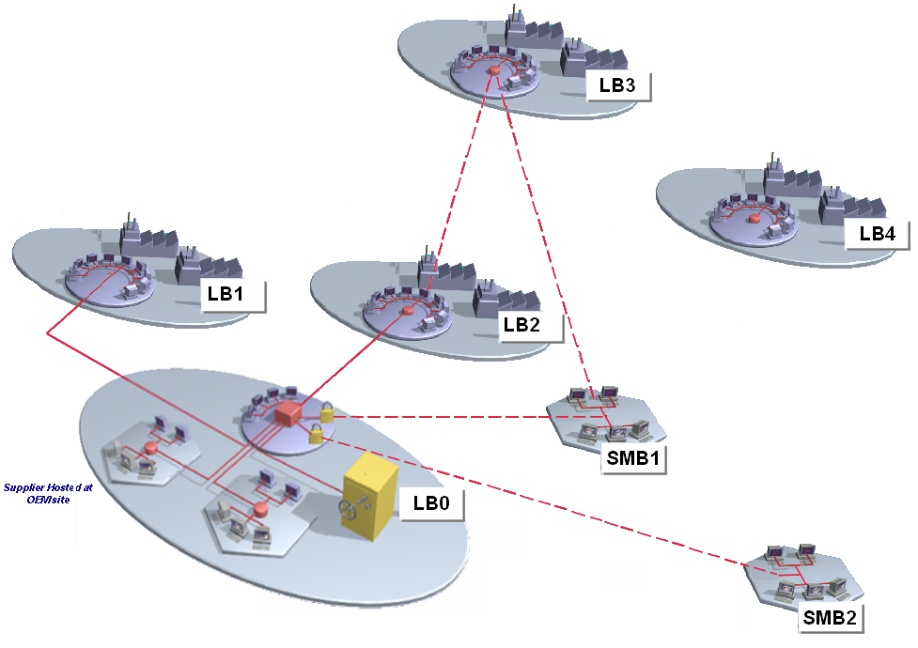
Data Exchange V6 / V6: Multi Releases Support
OEM should encourage their suppliers to use a V6 Release within the same Major Release Cycle as theirs
Rx-2
This not supported as of today.
Previous major cycle
Same major release cycle
Supplier
Unknown metadata attribute in lower release level are ignored ; such objects are tagged => restrictions on transfer ownership.
Rx-1
Supplier
Stream compatibility rules at runtime will detect and process any unknown feature situation ; Stream is not editable in this case.
OEM
CD
Rx
Supplier
OEM Rx
During import, new metadata attributes in upper release level are filled with default values.
Rx+1
Supplier
3DXML/Briefcase coming from the next major cycle is not supported.
Unknown metadata attribute in lower release level are ignored ; such objects are tagged => restrictions on transfer ownership.
Stream compatibility rules at runtime will detect and process any unknown feature situation ; Stream is not editable in this case.
During import, new metadata attributes in upper release level are filled with default values.
If 3DXML / Briefcase comes from a previous Major cycle, conversion tool needs to be run prior to Import. Limitations expected.
Rx+2
Conversion tool needs to be run prior to Import. Limitations expected. Plan to be confirmed
Supplier
Next major cycle

Slide 32
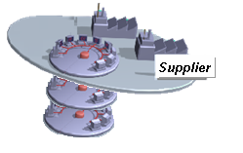
Data Exchange V6 / V6: Multi Releases Support
Suppliers can communicate with OEMs within the same Major Release Cycle and use converters otherwise
Upward and Downward conversion for Rx-2 and Rx+2
Rx-2
Previous major cycle
OEM
Same major release cycle
Rx-1
OEM
Rx
OEM
Supplier should have a server for Rx-1 or Rx or Rx+1
Rx+1
OEM
Upward and Downward conversion for Rx-2 and Rx+2
Rx+2
OEM
Next major cycle

Slide 33
Remote Access V6 / V4/V5

Slide 34


Data Exchange V4/V5 > V6: Overview
Optimizes Heterogeneous Supply Chain Data Exchanges
CATIA V5 files can be imported and converted into V6 format
Tool: File Based Data Import (FBDI)
CATIA V6 data can be exported and converted into V5 format
Tool: CATIA Downward Compatibility (CATDWC)
CATIA V4 files can be referenced within a V6 product structure
Tool: File Based Data Import (FBDI)
CATIA V6 representations can be exported as V4 .model
CATIA V6
CATIA V4/V5
CATIA V4/V5 files
OEM
Partner
Notes:
CATIA V6 files can be exported as V4 .model (CATPart only)

Slide 35
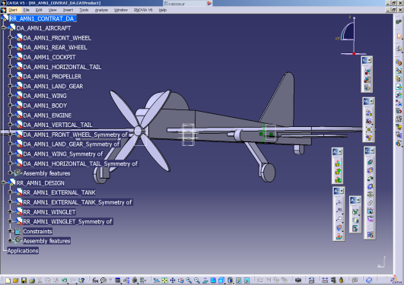
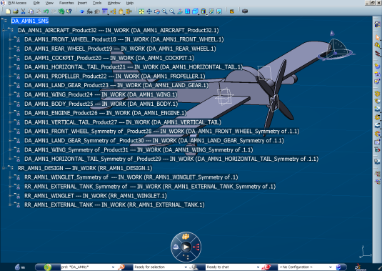
Data Exchange V4/V5 > V6: File Based 1/3
File Based Data Import (FBDI)
Product Structure with IP and external links
Result Product Structure
with IP and external Links
Drawing
Result Rep. Drawing
All data created by V5 applications, that have an equivalent in V6, are migrated.
V5
V6
Process
Process
Documents Migrated in V6
CATPart, CATProduct, CATDrawing, CATAnalysis, CATMaterial, Catalog, Non CATIA Document such as xls file for Design table, jpg ..
Data Migrated in V6
All features in the CATPart (Part Design, GSD, Composite, Sheet Metal, etc.)
Product Structure (References Product , Instances, Publication..)
Contextual links, References links, Assembly constraints
Material; Drawing, 2DLayout, FT&A
Knowledge Parameter , Formulas, Design table, Rules, Check
Other application data : FSK, Fasteners (ABF), DMU Data , Rendering, KIN, Analysis, Electrical, Tubing Machining.
Operating Mode
Interactive or batch mode,
Capability to identify already imported data allowing incremental migration of large assemblies and avoiding data duplication.
V6R2009 GA

Slide 36

Data Exchange V6 > V4/V5: File Based 2/3
CATIA Downward Compatibility (CATDWC)
Product Structure with IP and external links
Result Product Structure
with IP and external Links
Drawing
Result Rep. Drawing
V5
V6
Process
CATDWC always generates new documents from PLM Objects and Representations
CATDWC does not convert Specifications
Product structure instance/reference positioning
Product attributes (Part Number, Instance name, other attributes and users attributes on Reference)
3D Geometry as result (only visible geometry)
Feature Name, structures (Part bodies, geometric sets, graphical attributes on element and sub elements, layers… ) in the CATPart
A downwarded 3D Part can be
Opened; Measured; Drawn; Manufactured
V6R2009 GA
« As result » Description
Datum (With TR, Dress-up) | YES
Metadata as User properties | YES
Associative Datum to V6 | YES
Geometry specification (Feature) | NO
Publications | Candidate
Users Parameters | NO
Design tables and knowledge rules | NO
Drawings | As picture
3D Annotations (FTA) | As result

Slide 37
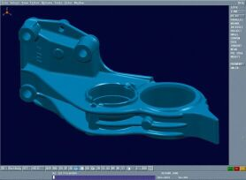
Data Exchange V4/V5 > V6: File Based 3/3
File Based Data Import (FBDI)
V4 model can be integrated to a V6 structure without converting it to V6
Capacity to copy/paste data from V4 to V6
V4
V6
V4 model can then be referenced into any V6 structure without converting it to V6
Reuse V4 product structures into any other V6 structures.
V4 model can also be converted into CATIA V6 format
Copy / Paste of V4 data into a V6 representation
Interactive process. Batch planned.
‘As Result’ – get the geometry only
Some modifications possible through ‘Feature Recognition’ tool for instance
‘As Spec’ – get the history, modify design
Only for Solid objects
Conversion of drawings: V4 Draw to V6 representation
Drawing edit capability; FT&A non associative to 3D, need to be done after.
CATIA V4 minimum level is CATIA V4R1.9
V6R2009 GA

Slide 38

Data Exchange V6 / V4/V5: Keep Relational Links
Supplier adds data:
Eg: new drawing or new parts
Context done by OEM in V6
And sent to the supplier who works in V5
Data are reimported in V6
1
2
3
4
3D shape are exported as « copy with link »
Replace mode on data previously carried over
FBDI works in replace mode on data already migrated
CATDWC
FBDI
OEM
Assy
OEM
CATProduct
OEM
CATProduct
OEM
Assy
OEM
Part
OEM CATPart
import
OEM CATPart
import
OEM
Part
3D Shape
feature
3D Shape
feature
OEM
Part
OEM CATPart
Import
OEM CATPart
import
OEM
Part
3D Shape
feature
3D Shape
feature
SUP CATDrawing
SUP
Drawing
V5 work in context of V6 data
drawing
V6 data
V5 data
Links are automatically rerouted on initial parts
ITERATIONS

Slide 39
Remote Access V6 / Other Systems

Slide 40
Remote Access V6/V4/V5: Overview
Leverages Online V6 Access to Provide a Non Intrusive Solution to Partners
OEM
Partner
CATIA V6
Check in
ENOVIA V6 Designer Central
WAN
CATIA V4/V5
Client Designer Central
Checkout + load
Limited footprint solution for the Partner
Partner accesses V6 context and delivers his V4/V5 design through ENOVIA Design Central which is hosted by the OEM

Slide 41
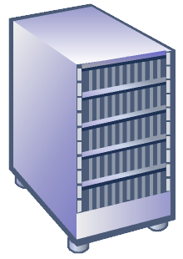

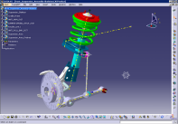



Remote Access V6/V4/V5: Synoptic V6R2009x
OEM
CATIA V5 with ENOVIA Collaborative Design for CATIA V5 (CT5)
1
Access and Navigate on OEM Designer Central Data Base
2
OEM Administrator provides V5 data (partial clone of V6 Product structure) into Designer central
V6 Product Structure
Designer Central
V4/V5 designer
3
Checkout + Load
Partner
CATIA V5 with ENOVIA Collaborative Design for CATIA V5 (CT5)
6
Modifies design into a CATIA V5 session
OEM Administrator Synchronizes V6 Product Structure
with V5 data coming from the Partner
4
V6 Product Structure
Designer Central
V4/V5 designer
5
Checkin

Slide 42

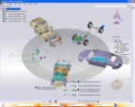

Remote Access V6/V4/V5: Synoptic V6R2009x (LA)
OEM
1
Access and Navigate on OEM V6 Product Structure
2
OEM Administrator provides V5 data (partial clone of V6 Product structure) into Designer central
V6 Product Structure
CATIA V5 with ENOVIA Collaborative Design for CATIA V5 (CT5)
Designer Central
3
Checkout + Load
V4/V5 designer
Partner
Access and Navigate on OEM V6 Product Structure
6
3D Live
Modifies design into a CATIA V5 session
4
6’
V6 Product Structure
Synchronizes V6 Product Structure
with V5 data
CATIA V5 with ENOVIA Collaborative Design for CATIA V5 (CT5)
Designer Central
5
Checkin
V4/ V5 designer

Slide 43
Remote Access V6/V4/V5: Synoptic
Target
OEM
Access and Navigate on OEM V6 Product Structure
1
3D Live
2
Provides V5 data (partial clone of V6 Product structure) into Designer central
V6 Product Structure
CATIA V5 with ENOVIA Collaborative Design for CATIA V5 (CT5)
Designer Central
3
Checkout + Load
V5 designer
Partner
Access and Navigate on OEM V6 Product Structure
6
3D Live
Modifies design into a CATIA V5 session
4
6’
V6 Product Structure
Synchronizes V6 Product Structure
with V5 data
CATIA V5 with ENOVIA Collaborative Design for CATIA V5 (CT5)
Designer Central
5
Checkin
V5 designer

Slide 44

Remote Access V6/V4/V5: Alternative
OEM
Partner
WAN
CATIA V6
V6
CATIA V4/V5
3DXML with Authoring
V6 <> V5 Data Conversion
Alternative where the Partner has a few seats of V6 to manage V6 to V6 exchanges.
It relies on the ‘3DXML for Authoring’ technology and mechanism seen in the ‘Data Exchange V6 / V6’ chapter.

Slide 45
Data Exchange V6 / Other Systems

Slide 46
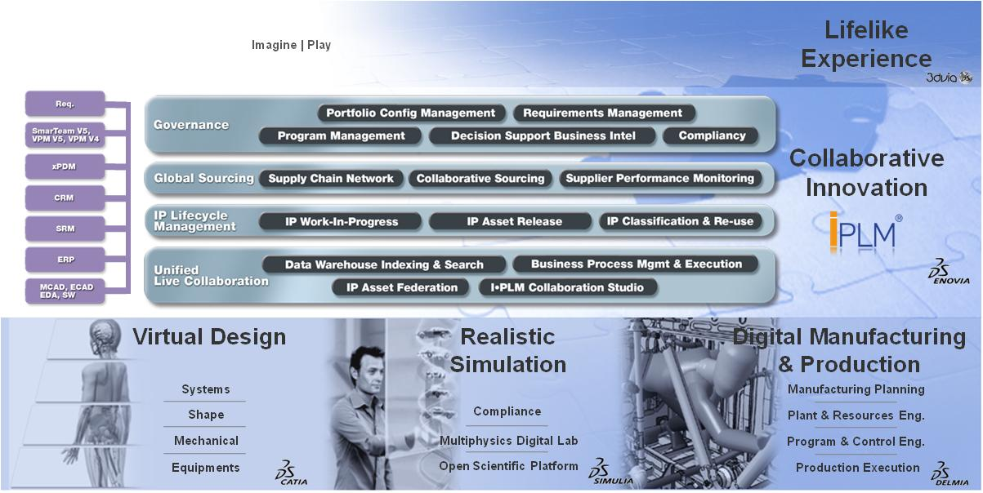
Remote Access V6 / Other Systems 1/4
Leverages a Single Framework for all MCAD Applications
ENOVIA Designer Central
Allows designers to manage their design information directly and all associated documents
Apply business process to merge design information with overall product development process (workflow, lifecycle mgmt, EBOM synchronization, etc)
Pro/ENGINEER
UGS NX
CATIA V4
CATIA V5
Solid Edge
SolidWorks
AutoCAD
Inventor
MicroStation

Slide 47
Remote Access V6 / Other Systems 2/4
Maximizes Collaboration with xCAD Designs
Manage xCAD data in V6 through direct xCAD integrations
Customers manage xCAD data and lifecycle through ENOVIA Designer Central directly from their xCAD application (i.e. DEC menus are immersed into their xCAD applications)
xCAD data available in Read-Only mode.
Scenario examples: ENOVIA Collaborative Business Processes in ENOVIA (such as Program Management, xBOM, etc); xCAD-V6 Design Review, Navigation from ENOVIA 3DLive; etc.
Manage xCAD data in V6 through indirect xCAD integrations
Customers without xCAD applications manage xCAD data files in V6.
xCAD data available in Read-Only mode.
Scenario examples: ENOVIA Collaborative Business Processes in ENOVIA (such as Program Management, xBOM, etc); xCAD-V6 Design Review, Navigation from ENOVIA 3DLive; etc.
Migrate xCAD into V6
Customers migrate xCAD files into V6.
xCAD data available can be authored in V6.
Both interactive and batch modes available.
Scenario examples: Continue a xCAD design in CATIA V6; ENOVIA Collaborative Business Processes in ENOVIA (such as Program Management, xBOM, etc); xCAD-V6 Design Review, Navigation from ENOVIA 3DLive; etc.
CATIA V4 / V5; AutoCAD; Inventor; Microstation; Pro/ENGINEER; Solid Edge; SolidWorks; NX
Target
Targets
V6R2010: IGES STEP V6R2010x: Pro-E, NX, etc.
Since V6R2009: IGES STEP
Target
V6R2010: Pro-E, NX, etc.
Target

Slide 48

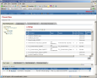
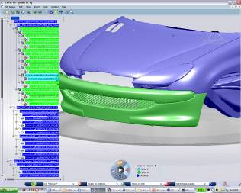

Remote Access V6 / Other Systems 3/4
Maximizes Collaboration with xCAD Designs
Partner
OEM
Integration through ENOVIA Designer Central
Synchronize (& update)
Authoring V6 (CATIA, DELMIA, SIMULIA)
Design Review
etc
1
ENOVIA Designer Central
ENOVIA VPM Central
xCAD
From the native CAD user interface
2
a1
p1
a1
a1
p2
p1
\\File
p1
CAD data Management
p2
p2
V6 Definition
xCAD data
Direct conversion into V6
3
\\File
a1
p1
p2
xCAD data
xCAD Converters provided by DS and/or CAA Partners

Slide 49



Remote Access V6 / Other Systems 4/4
Leverages V6 Unified Live Collaboration backbone to connect V6 with xPDM/ERP/CRM/etc systems
Desktop
Enterprise
Application Integration
OEM
Heterogeneous Collaborative Design & Engineering
IP Digital Asset Management
Point-to-Point (APIs)
xPDM Orchestration
IP Federation
MultiCAD
ProE, NX, …
xPDM
DS
Connectors
Pro-E
UGS NX
Supplier
TeamCenter
WinChill
VPM V5
VPM V4
SmarTeam V5

Slide 50
Data Exchange V6 / Other Systems

Slide 51



Data Exchange V6 / Other Systems 1/3
Leverages Open Standard Formats to Maximize Collaboration within Heterogeneous Environments
Direct STEP Import of PLM Engineering Data in V6
Import from external Product Data Management (PDM) system.
The data imported can be:
the Product Structure
the geometry in V5 or STEP format
Transfer of BOM and exact geometry

Slide 52



Data Exchange V6 / Other Systems 2/3
Leverages Open Standard Formats to Maximize Collaboration within Heterogeneous Environments
DXF, IGES2D, IGES3D, STEP AP214; AP203 ed1 & ed2
Interactive and/or batch processes
IGES3D, STEP: 3D Geometry, topology & product structure
STEP: advanced validation properties, such as Clouds of points on surfaces that guarantee the Geometry conversion integrity during an exchange
Native Part
COPS Validation
STEP Open
IGES:
Support of flexible assembly
STEP:
Support of flexible assembly
Support of COPS (validation properties)
Import of nested assemblies
DXF: Import/export
IGES : Import/export
IGES2D: Import/export
STEP: Import/export
Up Coming Release
V6R2009x CATIA V5R19

Slide 53




Data Exchange V6 / Other Systems 3/3
Leverages Industry Formats to Maximize Collaboration within Heterogeneous Environments
Partners providing JT to 3DXML Converter
Example of partnerships providing value by connecting industry standards for automotive value.
Functional Capabilities
Translation of single parts and assemblies
Convert JT BREP / Tessellated to 3DXML
Supports both JT_BREP & XT_BREP Precise Shape representations
Support JT PMI translation
Command line and CADverter
User Interface Support

Slide 54
Key Take Away
V6 technology and platform enable to accommodate many different types of Supply Chain typology, based on the specific collaboration rules and processes OEM and Suppliers want to establish.
V6 provides customers with flexible and complementary approaches to handle their Supply Chain interactions: Online / Remote Access and / or Data Exchanges.
V6 enables to cover many supply chain interaction scenarios, from simple / low semantic exchanges to complex collaborative business processes integration.
V6 supports heterogeneous environments, including V6 / V5 / V4 and relies on open standard formats such as STEP and IGES to address xPDM / xCAD collaboration.

Slide 55

Supply Chain Collaboration: Packaging
NOT a Customer Facing Slide
What needs to be installed?
V6R2009x
 | Ref. | Product Name | V6 / V6 Remote Access | V6 / V6 Data Exchanges | V6 / V5 Remote Access | V6 / V5 Data Exchange | V6 / xCADs Remote Access | V6 /xCADs Data Exchange
Partner | LIV | ENOVIA 3DLive | X | X | X
 | CT5 | ENOVIA Collaborative Design for CATIAV5 |  |  | X
 | DEC | ENOVIA Designer Central |  |  | X |  | X
 | CPF | ENOVIA Live Collaboration | X | X | X
 | VPM | ENOVIA VPM Central | X | X
 | FCS | ENOVIA File Collaboration Server | X | Optional but highly recommended | X |  | X
 | VSC | ENOVIA VPM Supply chain Collaborative engineering |  | X
 | xCAD | ENOVIA Collaborative Design for xCAD |  |  |  |  | X
OEM | LIV | ENOVIA 3DLive |  | X | X | X | X
 | CPF | ENOVIA Live Collaboration | X | X | X | X | X
 | VPM | ENOVIA VPM Central |  | X | X | X | X
 | FCS | ENOVIA File Collaboration Server | X | Optional but highly recommended | X |  | X
 | DEC | ENOVIA Designer Central |  |  | X |  | X
 | VSC | ENOVIA VPM Supply chain Collaborative engineering |  | X
 | STP | ENOVIA STEP Configured Interface |  |  |  |  | X | X

